Slide 1
Logistic Regression Part II

Slide 2
We have k classes. We should write equations for k classes like
Z₁ = W₁₁X₁ + W₁₂X₂ + W₁₃X₃ + …………….+W_{1n}X_{n}+b₁
Z₂ = W₂₁X₁ + W₂₂X₂ + W₂₃X₃ + …………….+ W_{2n}X_{n} +b₂
Z₃ = W₃₁X₁ + W₃₂X₂ + W₃₃X₃ + …………… + W_{3n}X_{n} + b₃
….. …….. …. ……. ……. ……. …….. ………. ….
Z_{k}= W_{k1}X₁ +W_{k2}X₂ + W_{k3}X₃+ …………..+ W_{kn}X_{n} +b_{k}
We start with random values of all the Ws and bs. We are given a training dataset. We start with the 1st example. Its class is A.
We calculate Z1 and find the probability of Class A. If it is correctly classified, we go to the next example. But if it is misclassified, we update the corresponding Ws and Bs using the formula W_{ij} = W_{ij} + ƞ(Y-Ỹ)X_{i}
X1 X2 X3 …… Xn
… …. …. …..
…. ….. …. …..
…. ….. …. ……
….. …… ….. ……
…… ….. …… ……
Class
A
A
B
C
C

Slide 3
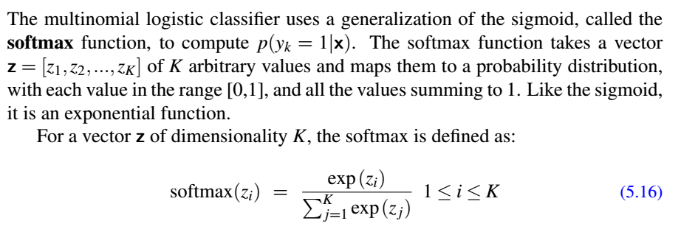
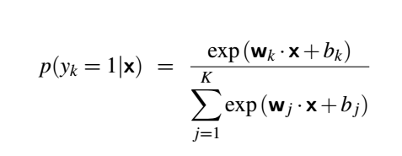
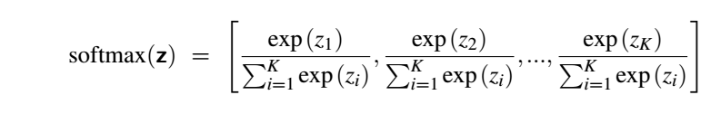

Slide 4
Suppose Z₁ = 0.6, Z₂ = 1.1, Z₃ = -1.5, Z₄ = 1.2, Z₅ = 3.2 and Z₆ = -1.1
Exp(0.6)
P(Y₁ = 1) =
Exp(0.6) + Exp(1.1) + Exp(-1.5) + Exp(1.2) + Exp (3.2) + Exp (-1.1)
Exp(1.1)
P(Y₂ = 1) =
Exp(0.6) + Exp(1.1) + Exp(-1.5) + Exp(1.2) + Exp (3.2) + Exp (-1.1)
and so on.
P( Y₁, Y₂, Y₃, Y₄, Y₅, Y₆) = [0.05, 0.09, 0.01, 0.1, 0.74, 0.01]
Predicted Class is Y₅
Suppose the actual class is Y₂
Loss = -log (0.09) = 2.41
W₃₁ = W₃₁ + 0.1 (1-0.09) X₁
W₃₂ = W₃₂ + 0.1 (1-0.09) X₂

Slide 5
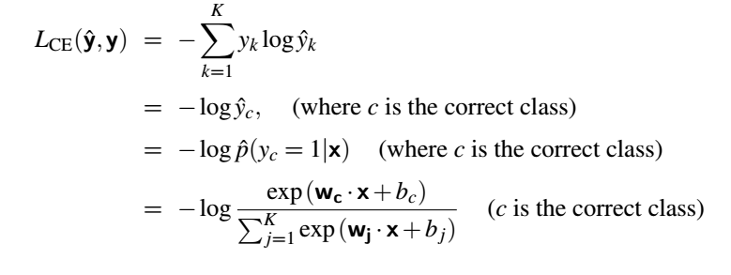
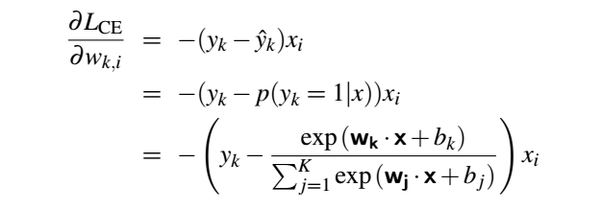
For two class problem cross entropy loss
For more than two class problem and K number of examples the total entropy loss is
= - log Y_{C} – log Y_{A} – log Y_{C} – log Y_{B} - ………… for K number of examples

Slide 6
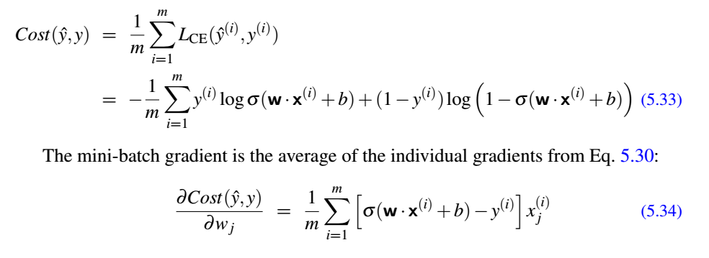
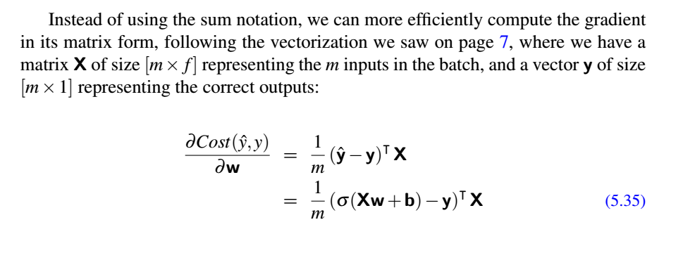
Stochastic vs Minibatch processing

Slide 7
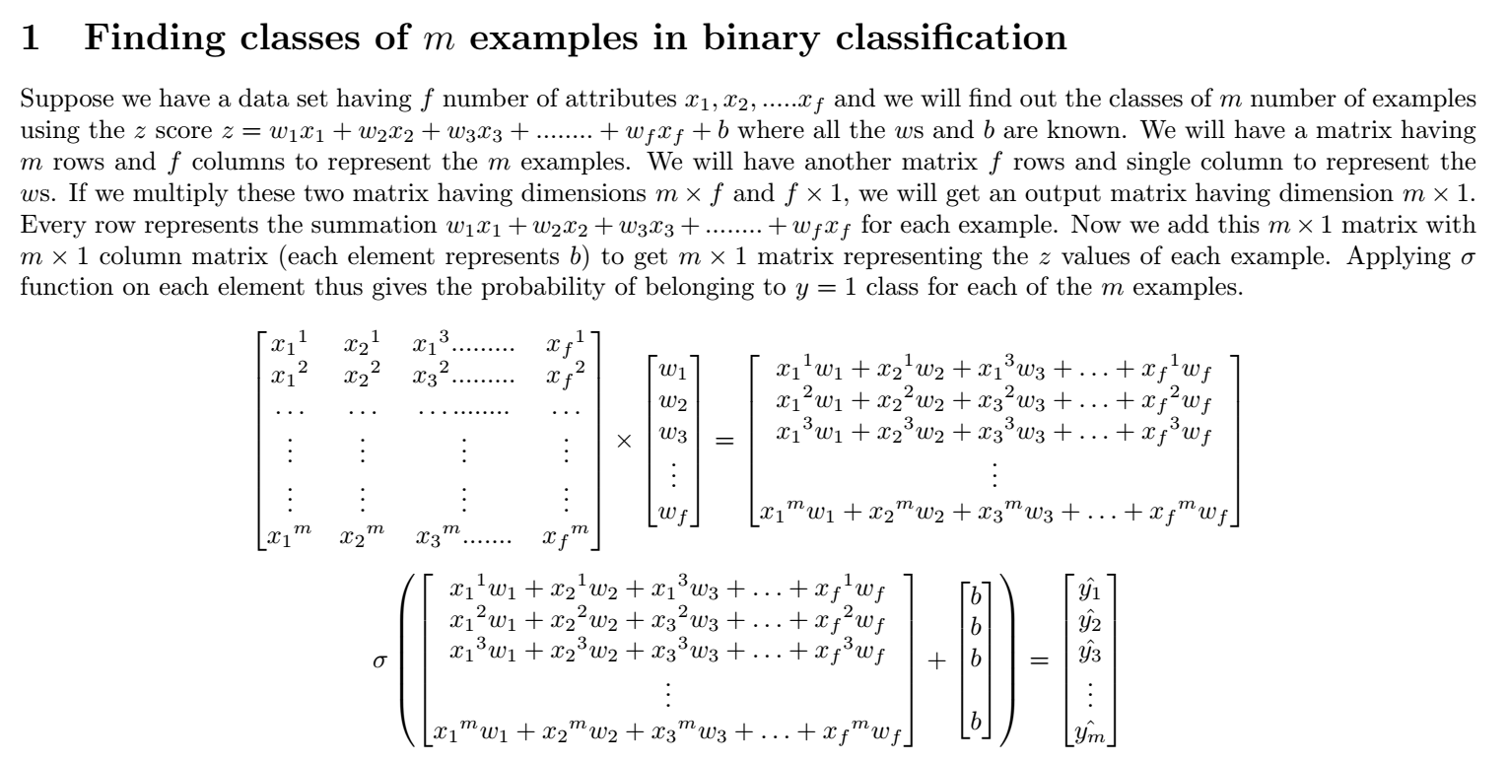

Slide 8
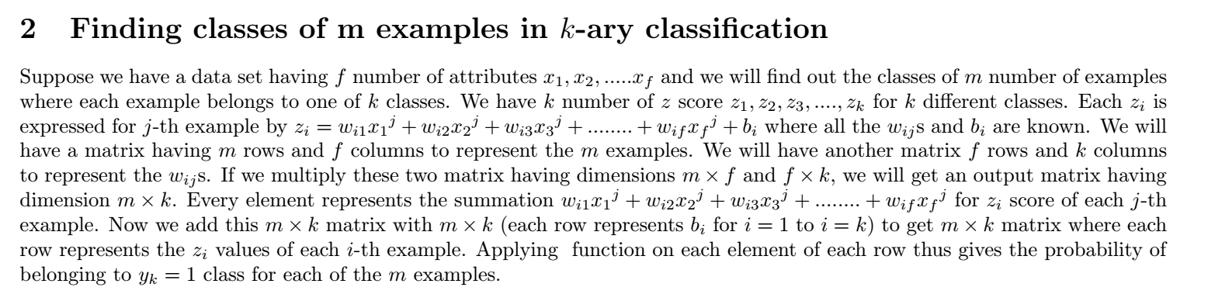
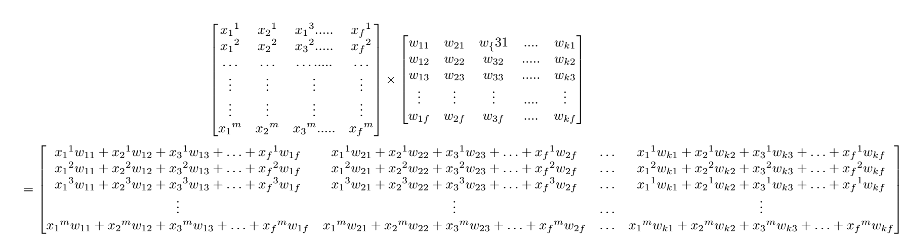

Slide 9
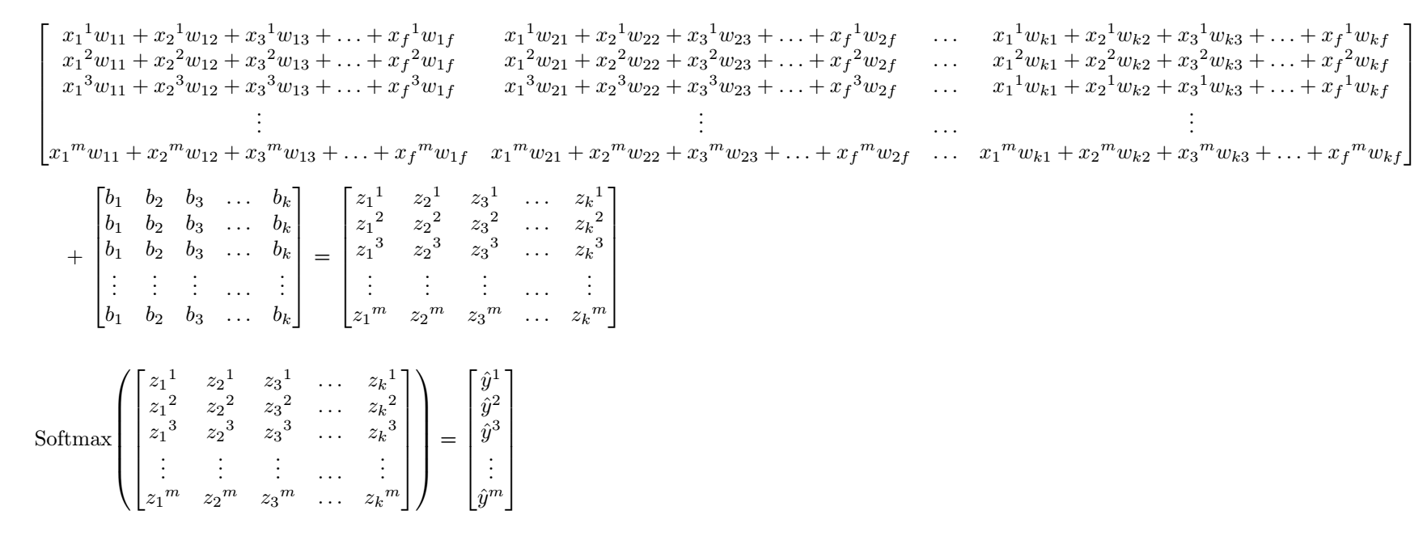

Slide 10
